Slide 1
Discussion - Week 4
Ali: Tue, 4-5.30pm
Darío, Thu, 12.30-1.50pm

Slide 2
BME 423 Discussion - Week 4
Outline
Probability
Examples (by-hand)
Examples with R probability distribution functions: pnorm(), qnorm()
II. ANOVA
How does ANOVA work?
Recap : ANOVA
Recap : The F Statistic
Example : Is inappropriate drug prescribing associated with a longer hospital stay?
In-class exercise : Are mood changes associated with the assigned antidepressant drug groups?
Guided Tour : aov()

Slide 3
pnorm()
Z: Standard Normal random variable
pnorm() → Calculates the cumulative probability. You specify a particular quantile q, and it tells you the probability of obtaining an outcome smaller than or equal to q .
Given x, find Prob(X<x) for some X~N(m,s²)
pnorm(q, mean = 0, sd = 1), where q is value of Z; function returns Pr.

Slide 4
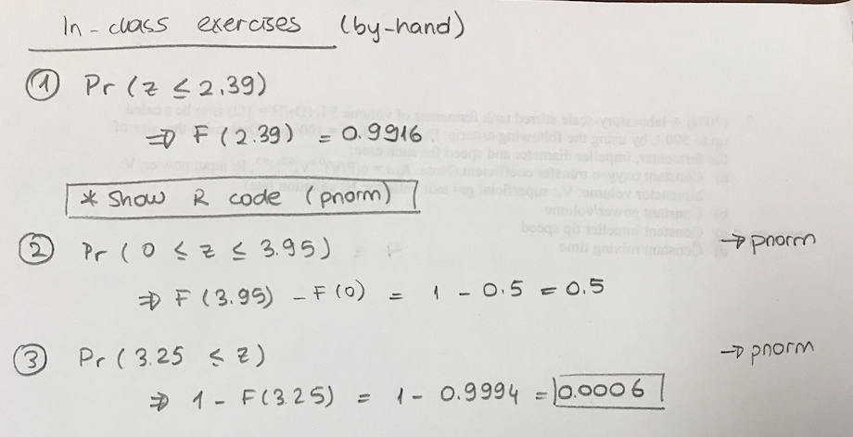
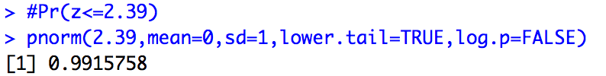
Probability Exercise
Notes:
The lower.tail and log.p settings are both the default settings, so it’s fine to mention them, but it is important to make it clear that it is not necessary to have in the written code

Slide 5
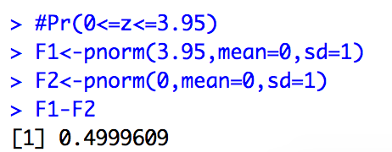
Probability Exercise

Slide 6
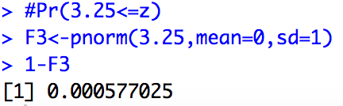
Probability Exercise

Slide 7
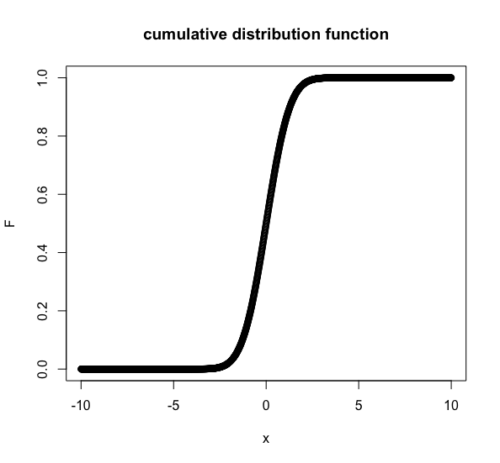
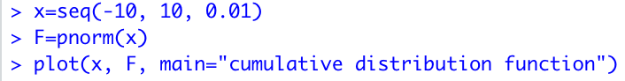
Plotting
Notes:
Note that mean – 0 and SD =1 (defaults)

Slide 8
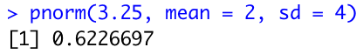
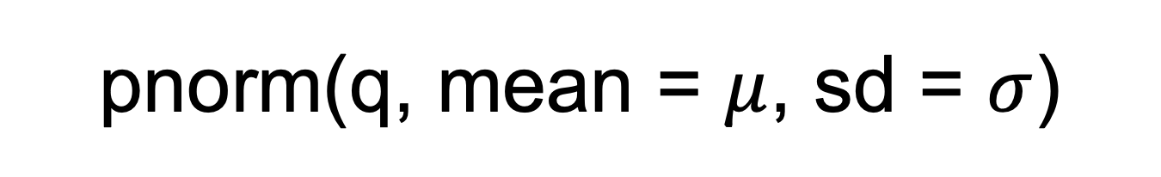
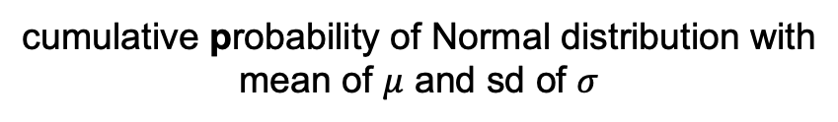
pnorm(q, mean = $μ$, sd = $σ$)
cumulative probability of Normal distribution with mean of $μ$ and sd of $σ$

Slide 9
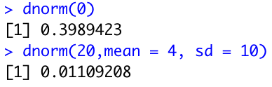
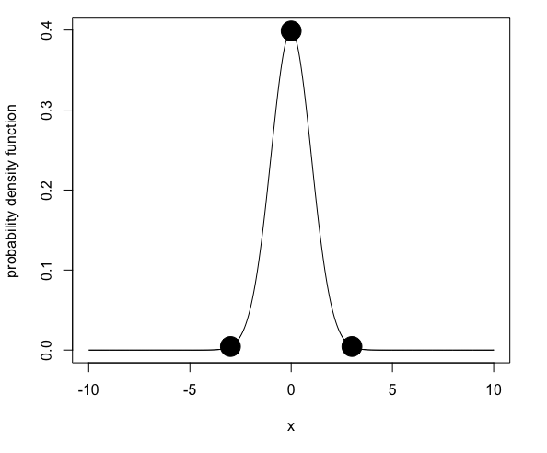
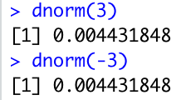
dnorm(q)
Probability density function of Standard Normal distribution
(dnorm() has mean = 0 and sd = 1 by default)
Notes:
pdf values for x=mean, x=mean - 3*SD, and x=mean + 3*SD

Slide 10
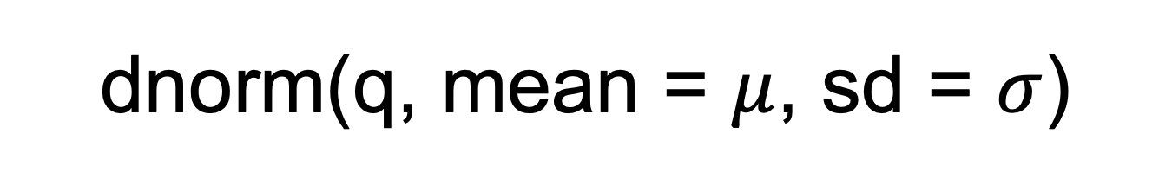
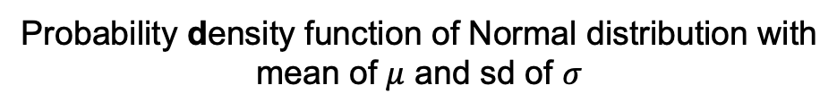
dnorm(q, mean = $μ$, sd = $σ$)
Probability density function of Normal distribution with mean of $μ$ and sd of $σ$
defaults: mean = 0 , sd = 1

Slide 11
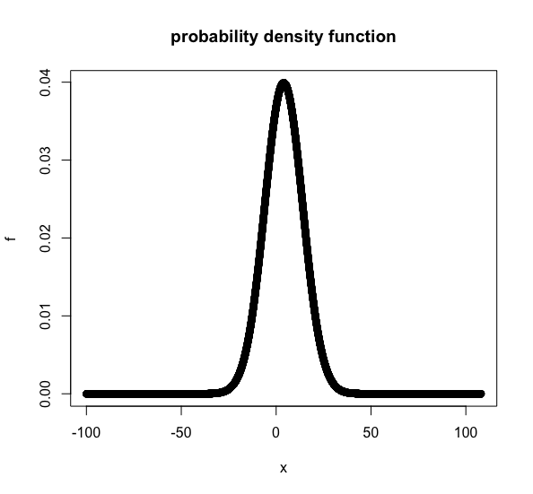

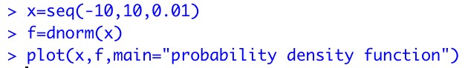
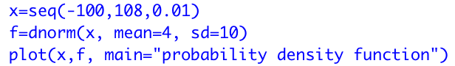
Plotting
Notes:
Please see next slide for the zoomed version of the plot on the right

Slide 12
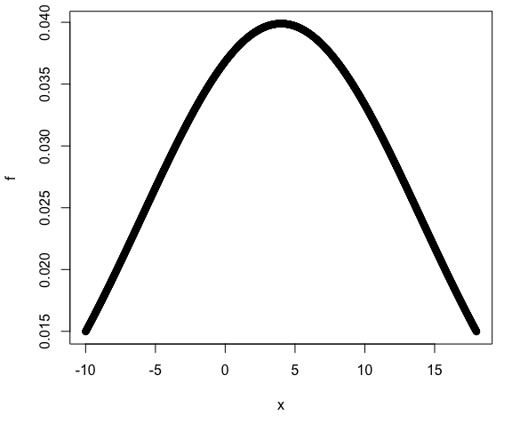
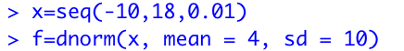
Plotting
(zoomed)
Notes:
The right plot is zoomed version of its previous slide view

Slide 13
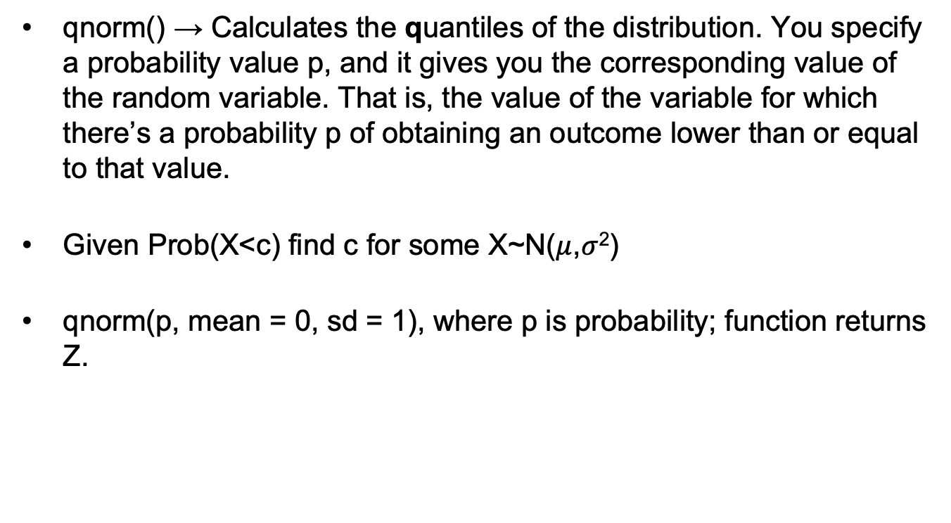
qnorm()
qnorm() → Calculates the quantiles of the distribution. You specify a probability value p, and it gives you the corresponding value of the random variable. That is, the value of the variable for which there’s a probability p of obtaining an outcome lower than or equal to that value.
Given Prob(X<c) find c for some X~N($μ$,$σ$²)
qnorm(p, mean = 0, sd = 1), where p is probability; function returns Z.

Slide 14
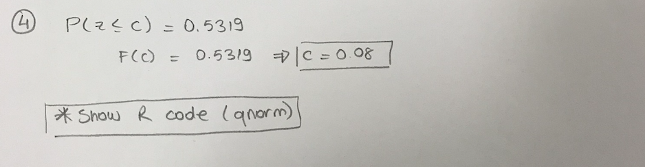
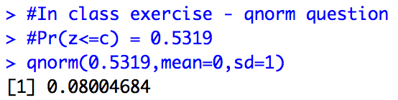
Quantile Exercise

Slide 15
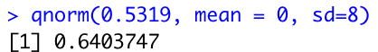
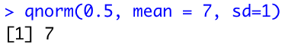
Quantile Exercise

Slide 16
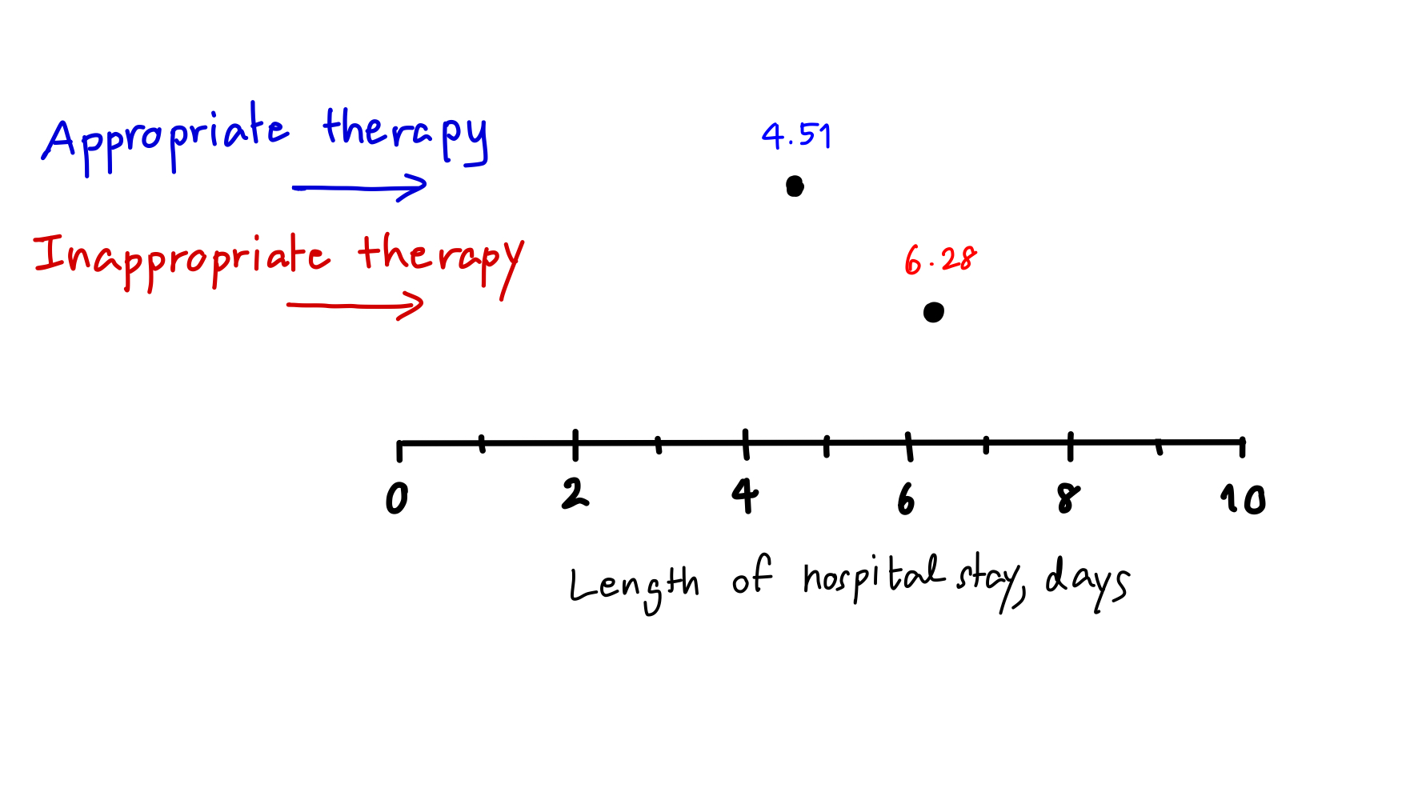
Can you tell if the sample means of the LoS between two groups are different?
LoS: length of hospital stay
On average, the appropriately treated patients were hospitalized for 4.51 days whereas the inappropriately treated patients were hospitalized for 6.28 days.

Slide 17
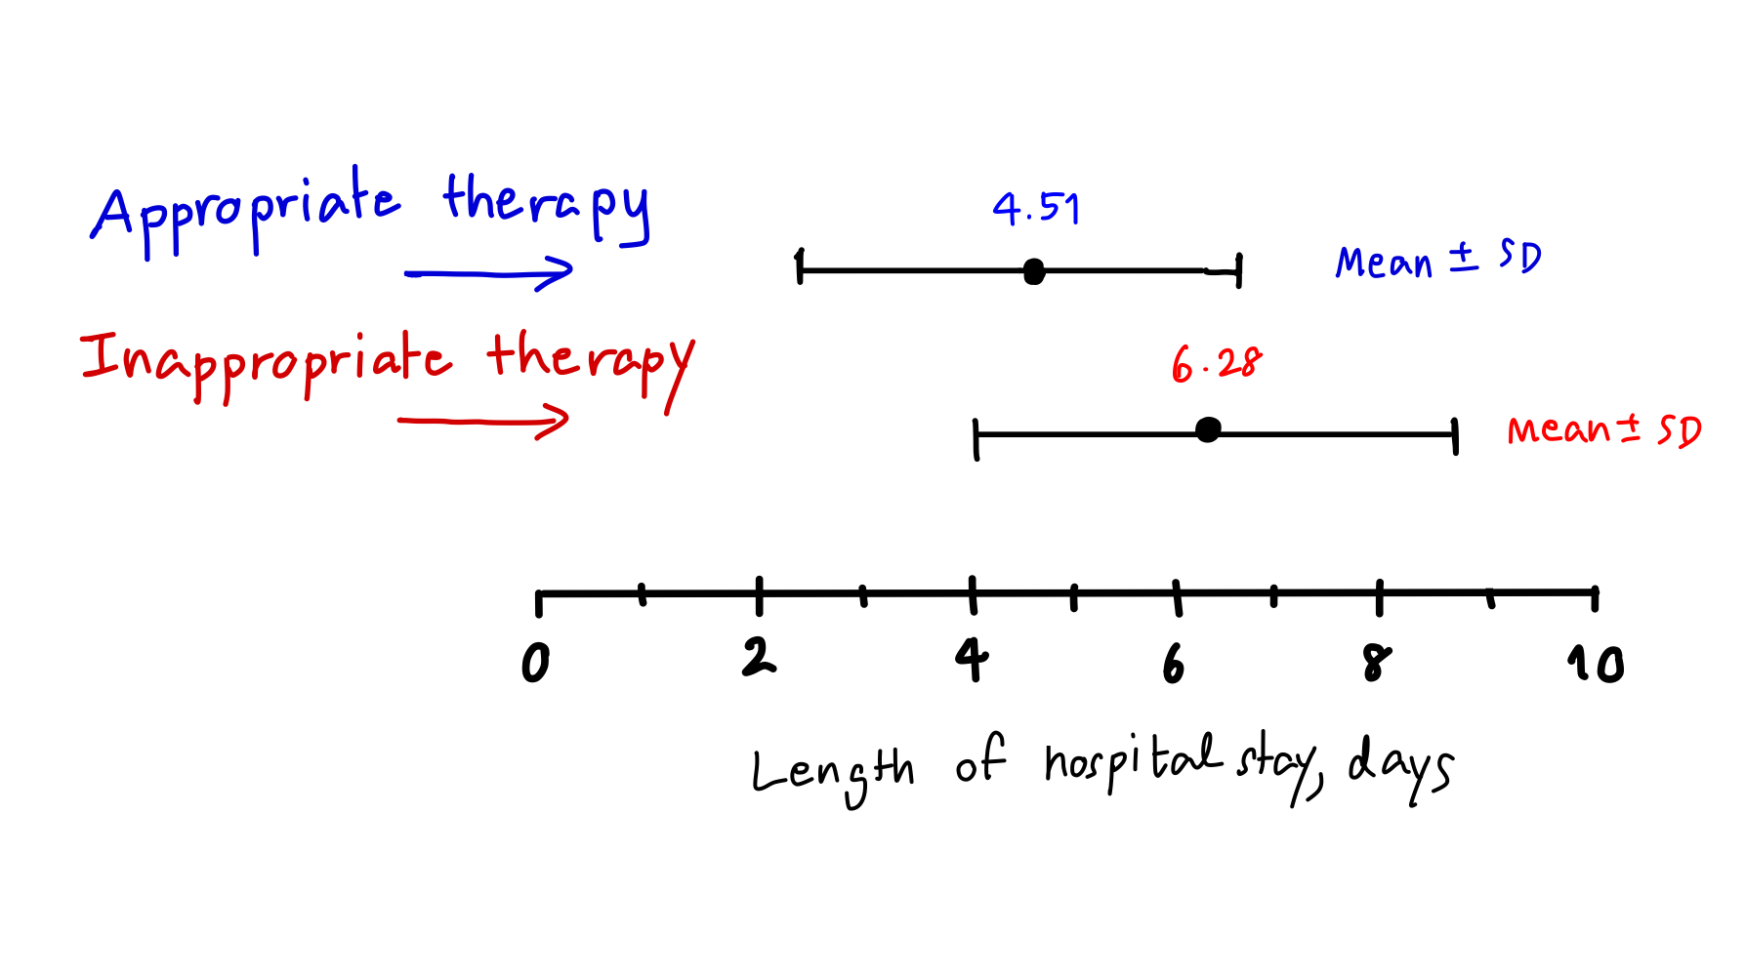
How to tell if the observed difference is not due to random variability within each group?
In order to evaluate the observed difference, we evaluate the variability in the sample means against the variability within each group.

Slide 18
Recap : Analysis of Variance (ANOVA)
We have several different groups of observations, and we’re interested in finding out whether those groups differ in terms of some outcome variable of interest.
ANOVA can determine whether the means of three or more groups are different.
ANOVA uses F-tests to statistically test the equality of means.
Null Hypothesis H₀: No difference in the group means among
C, P, S, and N groups
Notes:
F-value is related to how big Sbet and Swit are.

Slide 19
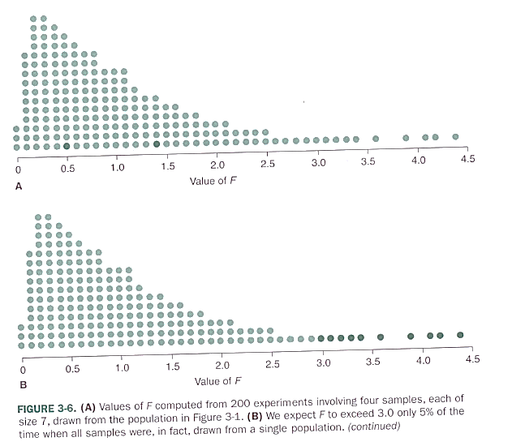
Recap : The F Statistics
F is a random variable
defined by a p.d.f. f(F)
What is a “Big”
value of F???

Slide 20
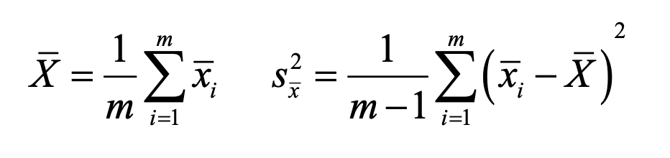
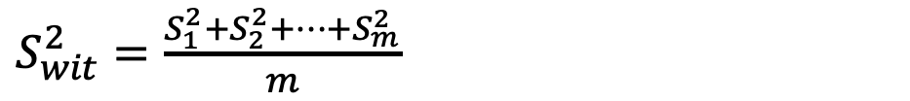
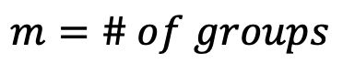
Recap : Calculate within-group variance & between-group variance
Get a better estimate of
$$m=\# of groups$$
1.
$S_{wit}^{2}=\frac{S_{1}^{2}+S_{2}^{2}+…+S_{m}^{2}}{m}$
Estimate of population variance using within-group variances
*Can use equations 1. & 2. only if all the groups have the sample size of n
2.
Estimate of population variance calculated from variance between group means
Now from samples:
Notes:
G = m
N = n

Slide 21
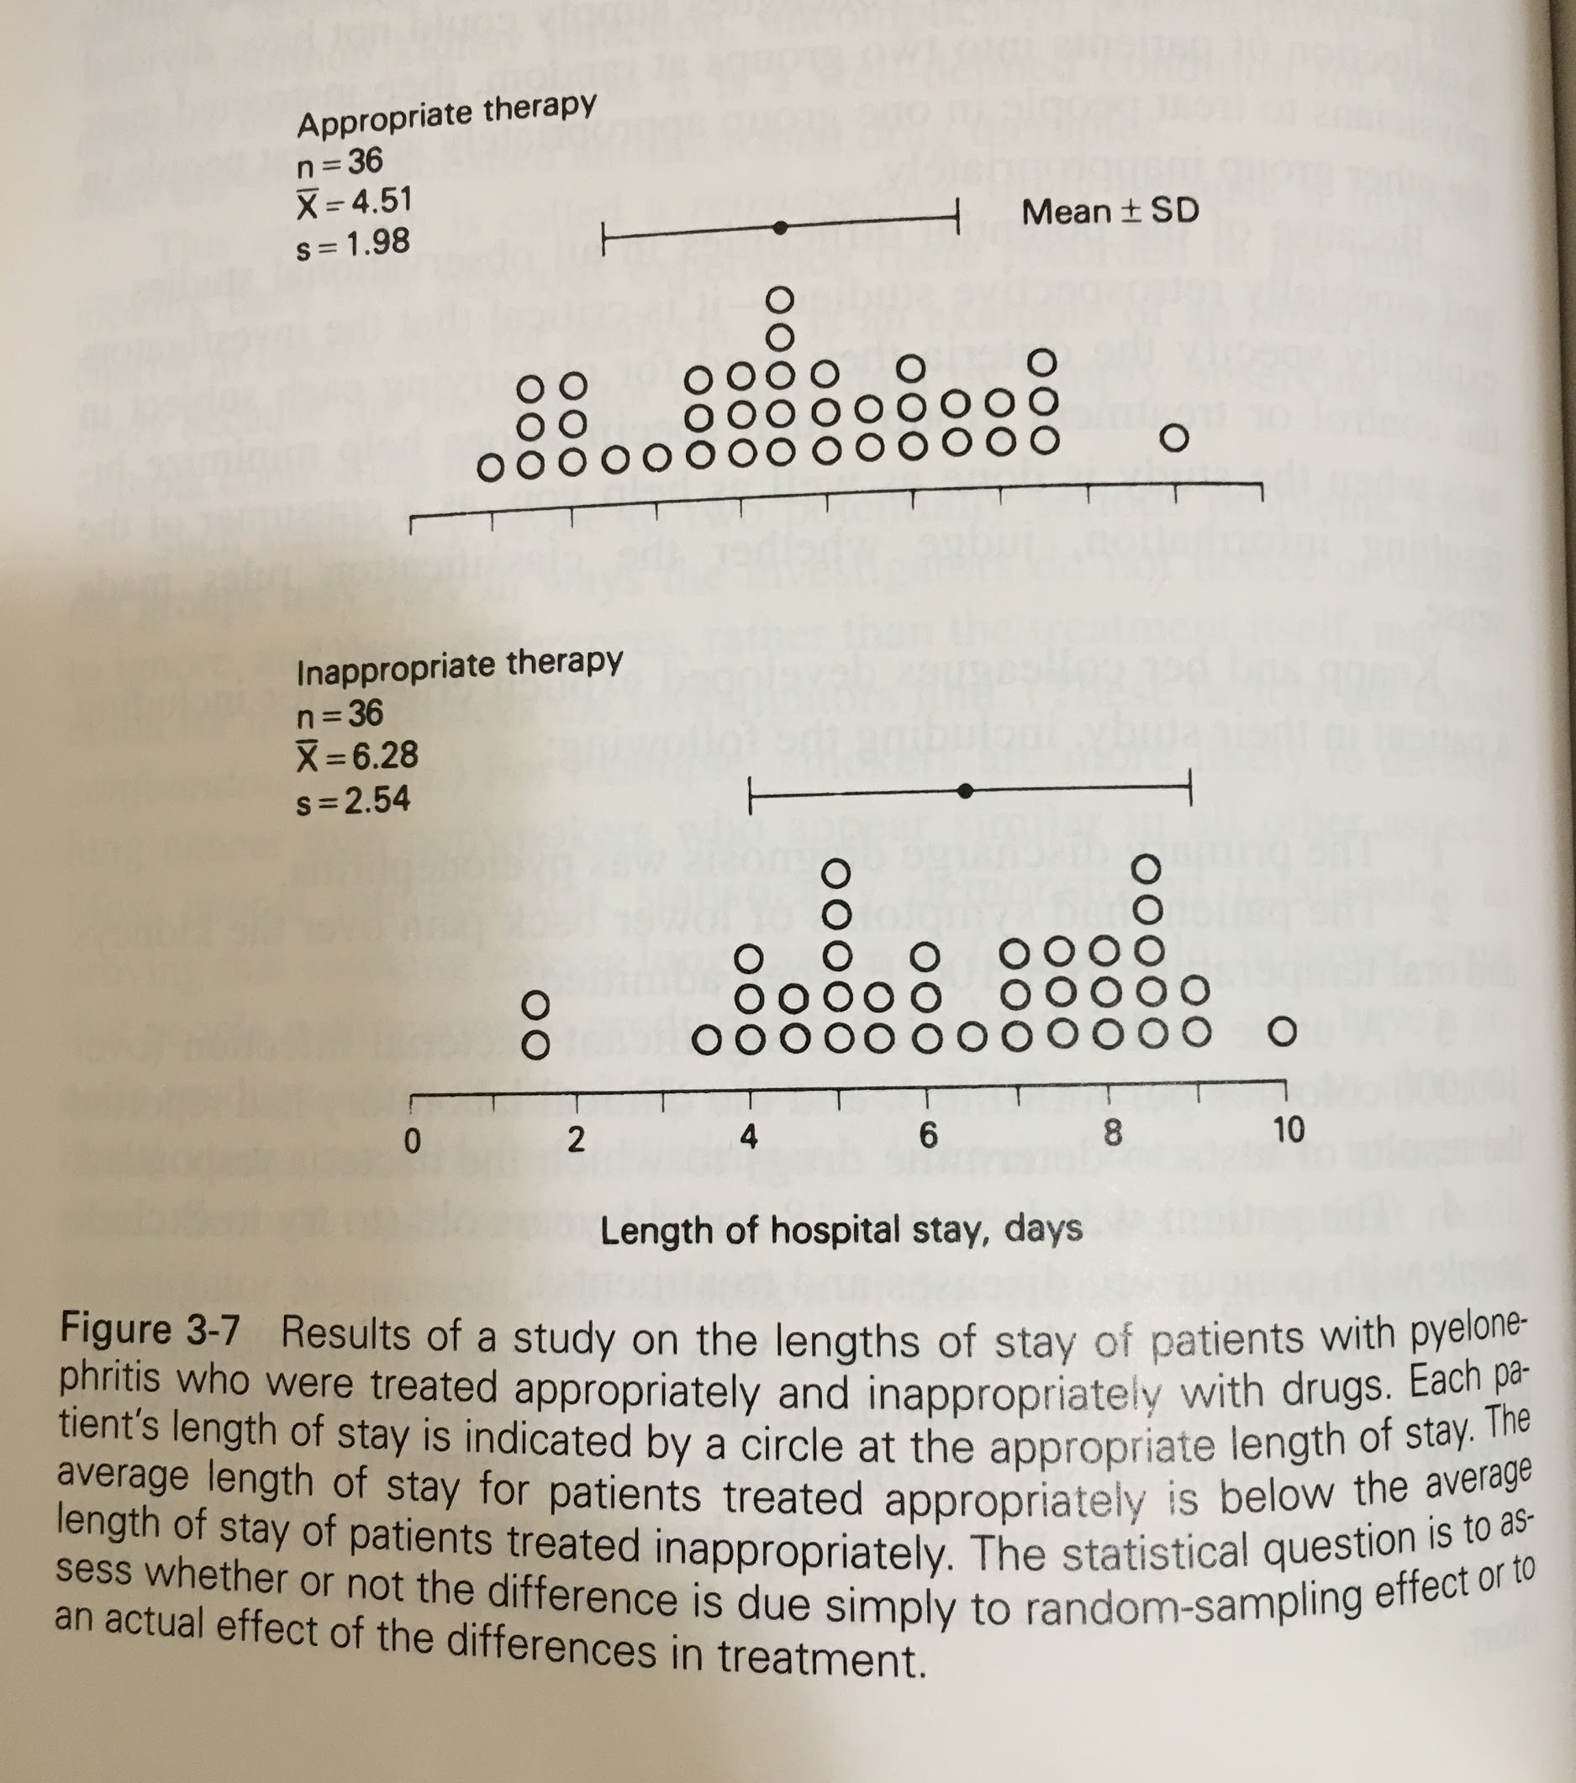
Is inappropriate drug prescribing associated with a longer hospital stay?
Grouping variable : Appropriate therapy vs. Inappropriate therapy
Outcome variable : Length of hospital stay (LoS)
Null hypothesis (H0):
The average LoS is identical
Alternative hypothesis (H1):
The average LoS is different
ANOVA tests the null hypothesis!

Slide 22
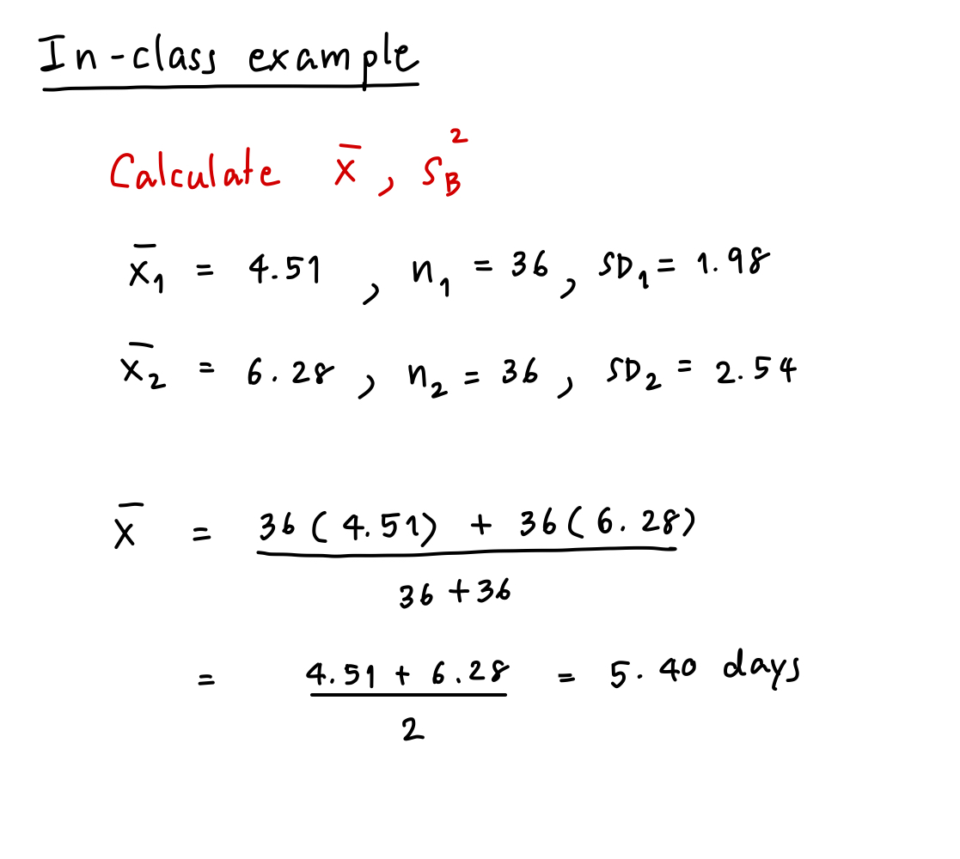
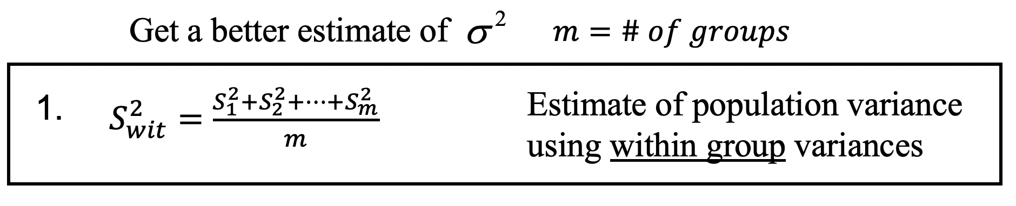
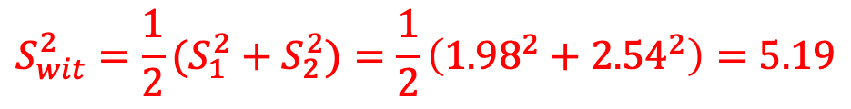
Calculate F-value: Within-group variance
$$S_{wit}^{2}={\frac{1}{2}(S}_{1}^{2}+S_{2}^{2})=\frac{1}{2}\left({1.98}^{2}+{2.54}^{2}\right)=5.19$$

Slide 23
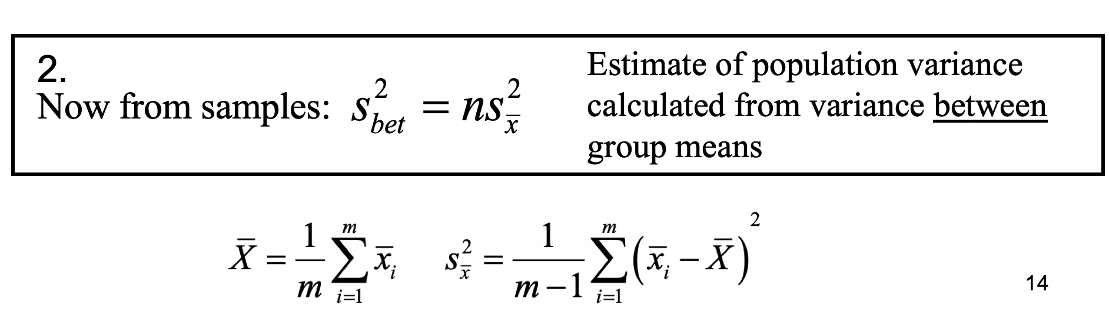
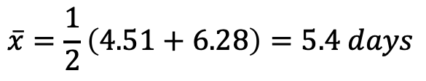
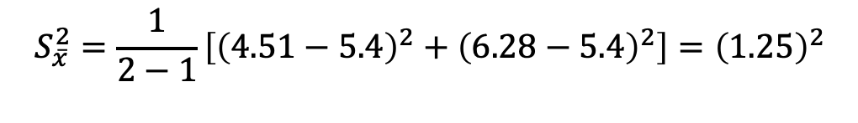
Calculate F-value: Between-group variance
$$\overline{x}=\frac{1}{2}\left(4.51+6.28\right)=5.4 days$$
$$S_{\overline{x}}^{2}=\frac{1}{2−1}\left[{\left(4.51−5.4\right)}^{2}+{\left(6.28−5.4\right)}^{2}\right]={\left(1.25\right)}^{2}$$
$$S_{bet}^{2}=nS_{\overline{x}}^{2}=36{\left(1.25\right)}^{2}=56.25 days^{2}$$

Slide 24
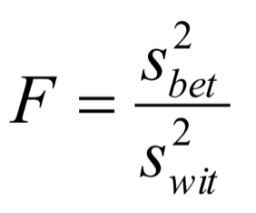
Evaluate F-value using the F-table
= 56.25 / 5.19 = 10.84
The F-value is associated with the numerator and the denominator.
v_{n}= m-1 = 2-1=1
v_{d}= m(n-1) = 2(35) = 70
m = # of treatment groups
n = # of subjects per group
We use v_{n} and v_{d} and the F-table to find how improbable or probable our calculated F-value is.
The table indicates that the probability of the F-value being larger than 10.84 is low.
Notes:
G=m
N=n

Slide 25
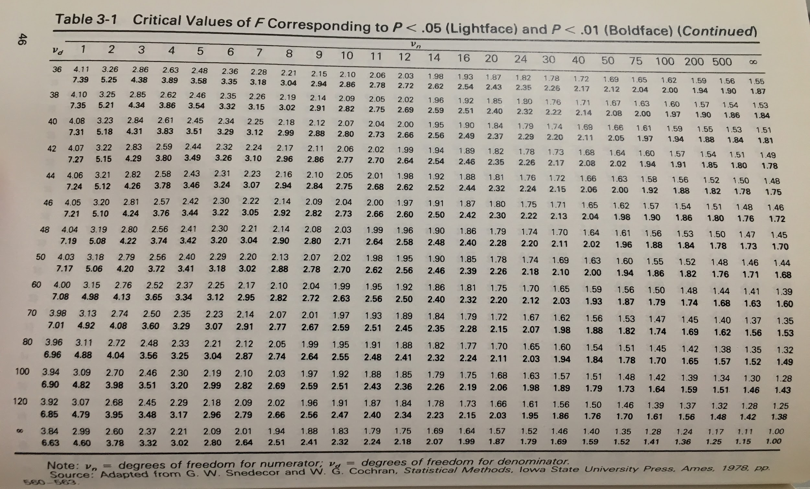
F=10.84, v_{n} =1, v_{d} =70
The probability of F being equal to 7.01 or larger than 7.01 is less than 0.01

Slide 26
Conclusion: H0 is rejected
The table indicates that there is less than a 1 percent chance of F exceeding 7.01 if the individuals truly were drawn from the same population, we therefore conclude that the value of F associated with our observations is “big” and we reject the null hypothesis:
Conclusion: Reject H0 with P < 0.01. There is a difference in LoS between the properly and improperly treated patients.

Slide 27
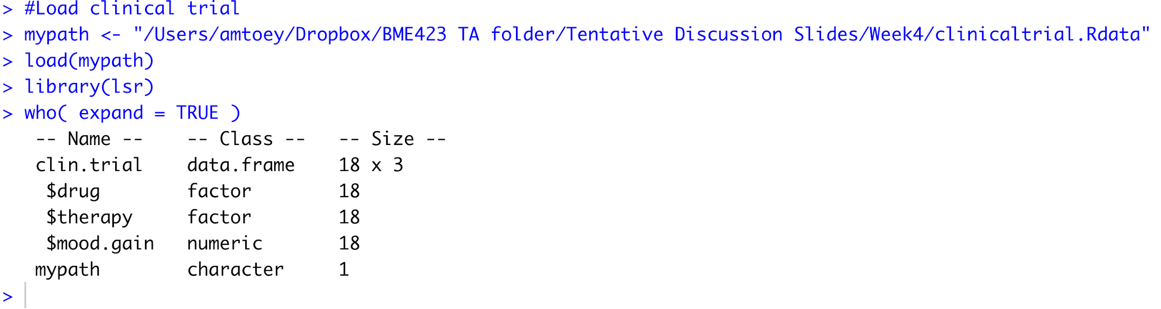
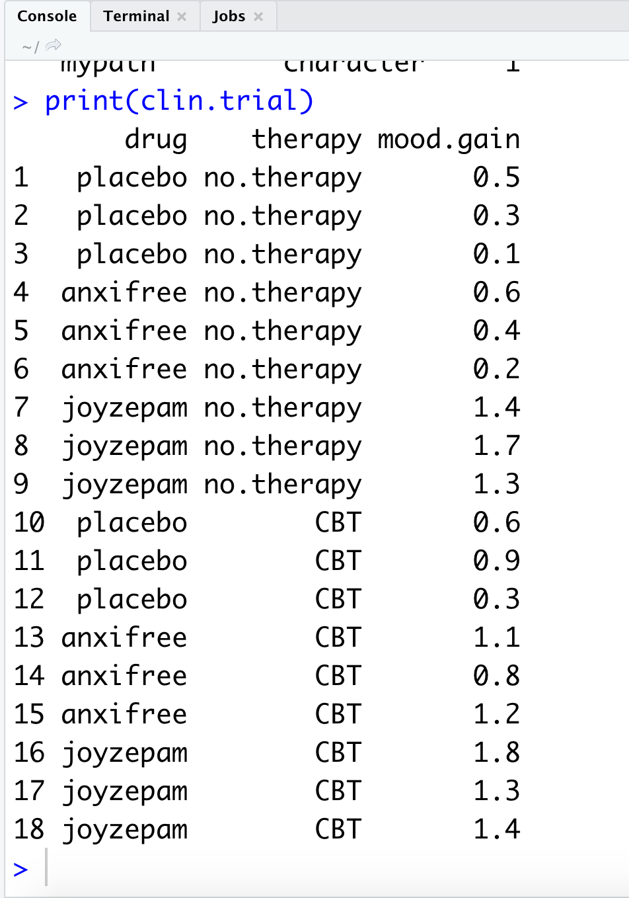
In-class exercise : ANOVA (by-hand)
Load “clinicaltrial.Rdata ”
Three different drugs : placebo, anxifree, joyzepam
Some patients undergo cognitive behavioral therapy (CBT)
mood is assessed on a scale ranging from -5 to +5.

Slide 28
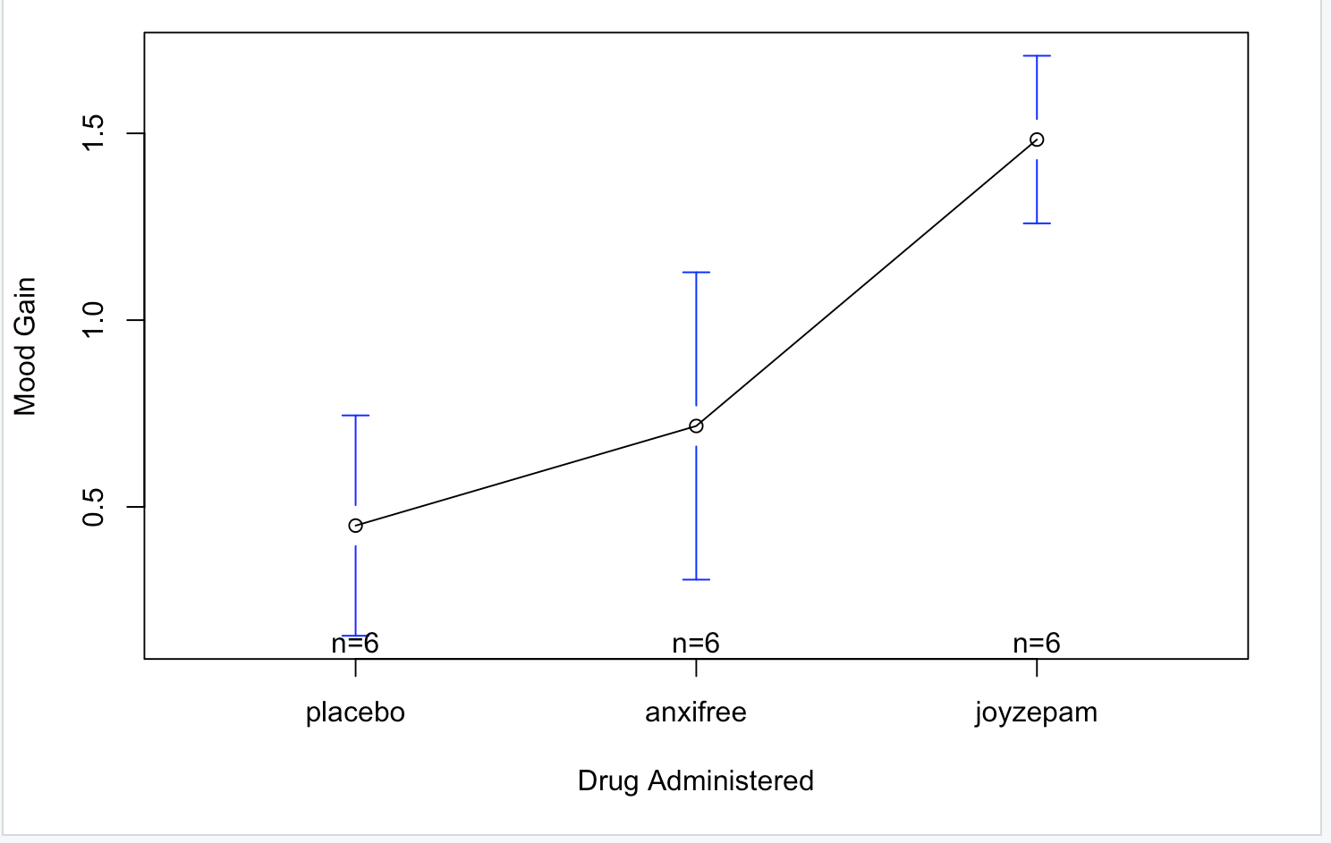
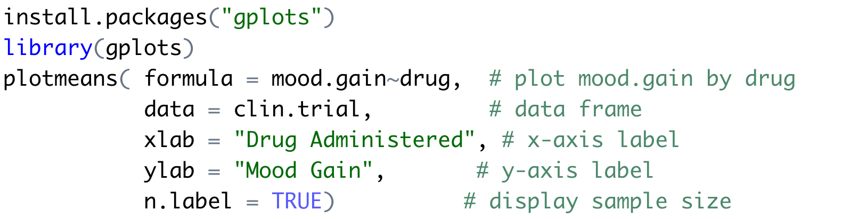
Notes:
As the plot makes clear, there is a larger improvement in mood for participants in the Joyzepam group than for either the Anxifree group or the placebo group. The Anxifree group shows a larger mood gain than the control group, but the difference isn’t as large. The question that we want to answer is: are these difference “real”, or are they just due to chance?

Slide 29
In-class exercise: Use ANOVA to test whether the effect of drug is associated with mood.gain
We’re really interested in the effect of drug on mood.gain.
Grouping variable : ?
Outcome variable : ?
Null hypothesis (H0): ?
Alternative hypothesis (H1): ?
Hints:
Calculate F-value, DF_bet and DF_wit
Use the F-table to assess the null hypothesis.
What’s the p-value?

Slide 30
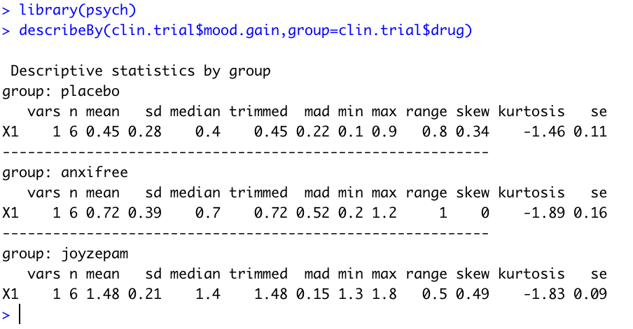
Use describeBy() to calculate means, variances for the mood.gain
We can use the describeBy() function to calculate means and standard deviations for the mood.gain variable broken down by which drug was administered:

Slide 31
In-class exercise: Detailed Description
Suppose you’ve become involved in a clinical trial in which you are testing a new antidepressant drug called Joyzepam.
In order to construct a fair test of the drug’s effectiveness, the study involves three separate drugs to be administered. One is a placebo, and the other is an existing antidepressant / anti-anxiety drug called Anxifree.
A collection of 18 participants with moderate to severe depression are recruited for your initial testing. Because the drugs are sometimes administered in conjunction with psychological therapy, your study includes 9 people undergoing cognitive behavioral therapy (CBT) and 9 who are not. Participants are randomly assigned (doubly blinded, of course) a treatment, such that there are 3 CBT people and 3 no-therapy people assigned to each of the 3 drugs. A psychologist assesses the mood of each person after a 3-month run with each drug: and the overall improvement in each person’s mood is assessed on a scale ranging from -5 to +5.
What we’re really interested in is the effect of drug on mood.gain.

Slide 32
In-class exercise: Answer sheet
Group | Mean | Variance
Placebo
Anxifree
Joyzepam
S²_{wit} =
S²_{bet} =
H₀ =
F-value = S²bet/S²wit =
v_{n}= ,v_{d}=
p-value =
Conclusion :

Slide 33
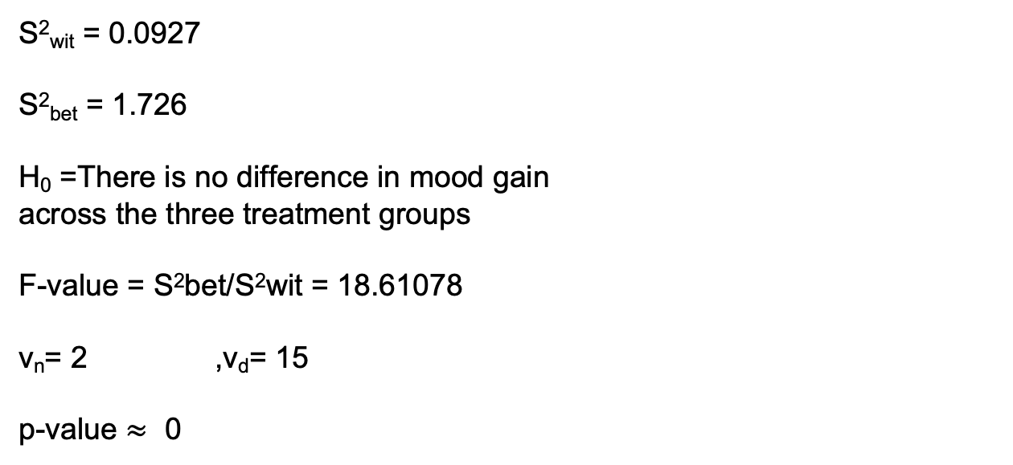
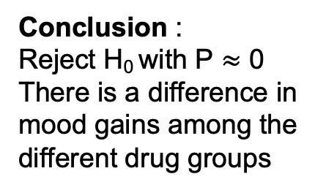
In-class exercise: Solution (Hidden!!)
Group | Mean | Variance
Placebo | 0.45 | 0.079
Anxifree | 0.7166667 | 0.1536
Joyzepam | 1.483333 | 0.0456
 | 0.883333
Please add H0 along the lines of:
“There is no difference in mood gain across the three treatment groups”
(I would have done it myself, but the formatting is being wonky)
S²_{wit} = 0.0927
S²_{bet} = 1.726
H₀ =There is no difference in mood gain
across the three treatment groups
F-value = S²bet/S²wit = 18.61078
v_{n}= 2 ,v_{d}= 15
p-value $≈$ 0
Conclusion :
Reject H₀ with P $≈$ 0
There is a difference in
mood gains among the different drug groups

Slide 34
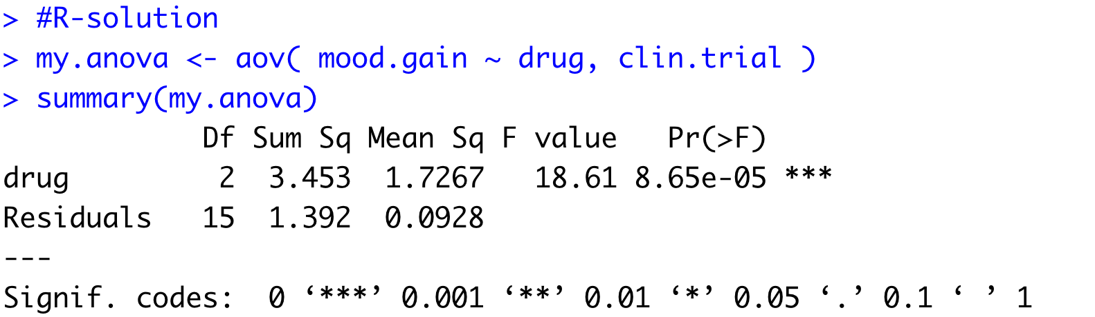
Guided Tour : aov()

